Slide 1
We remember our classmates

Slide 2
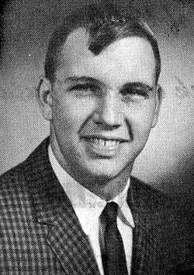
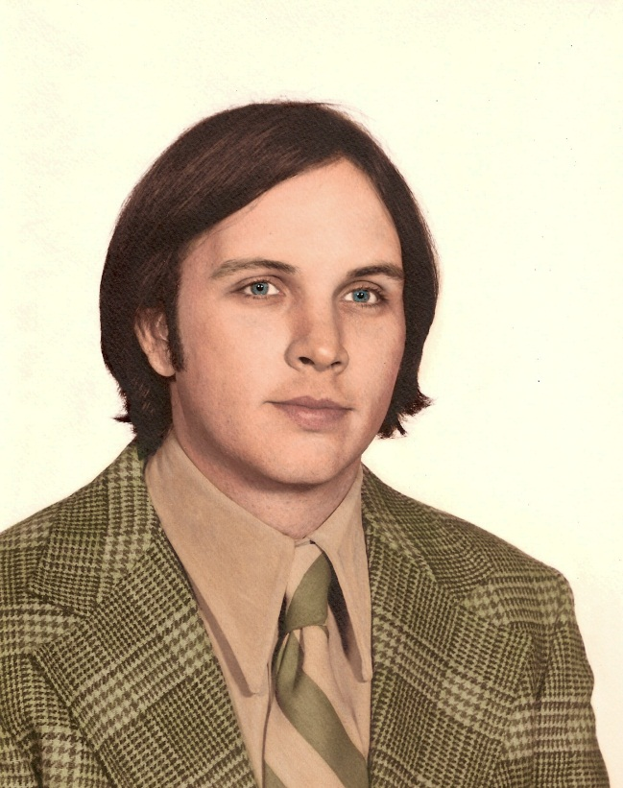
Ronald Eugene Keister
March 7, 1948 ~ April 10, 1976

Slide 3
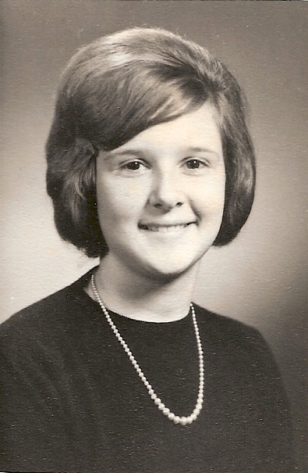
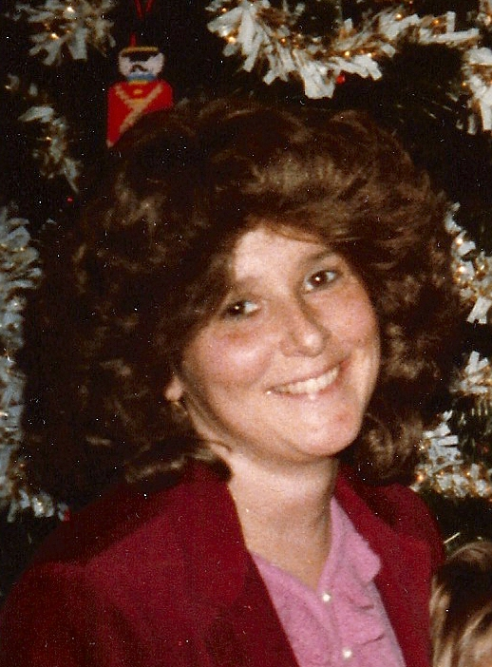
Diane Lavonne (Dreese) Knauss
September 15, 1948 ~ August 18, 1983

Slide 4
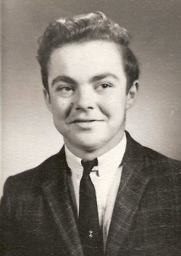
Joseph Robert Bowes
March 18, 1948 ~ May 1995

Slide 5
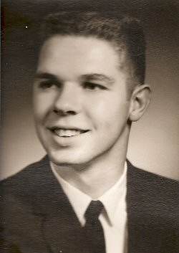
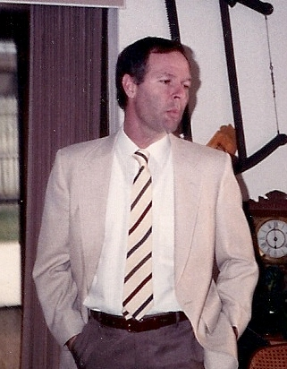
Donald Lynn Clark
November 18, 1948 ~ March 10, 1998

Slide 6
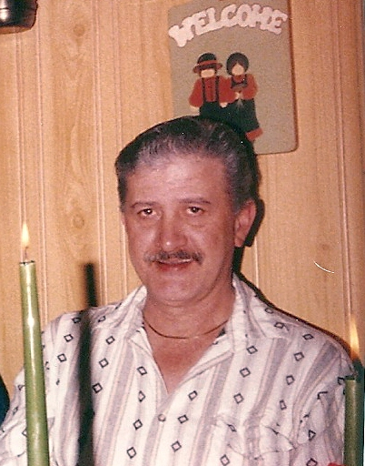
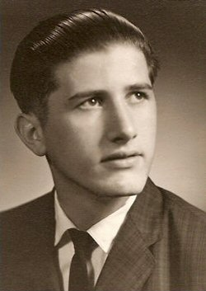
Roger L. Stahl
October 14, 1948 ~ May 2, 1998

Slide 7
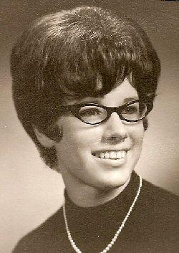
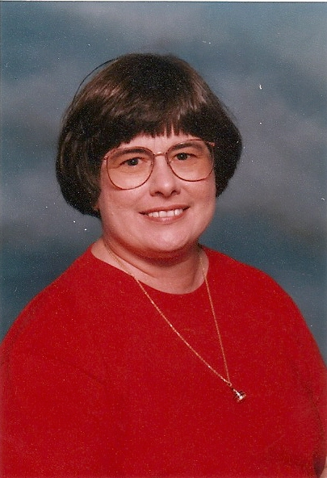
Brenda Ann (Shirk) Rowe
May 9, 1948 ~ April 20, 2002

Slide 8
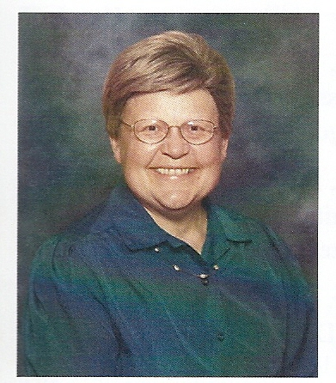
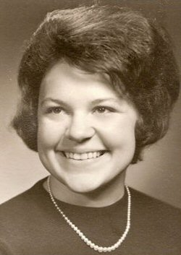
Linda Kay Walter
March 5, 1948 ~ April 30, 2003

Slide 9
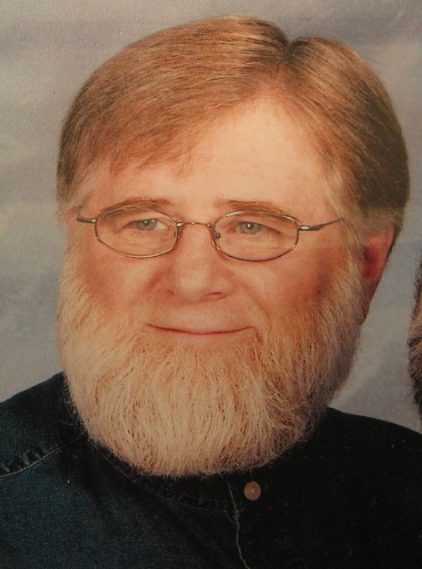
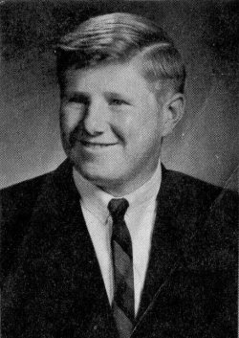
David Don Chapman
September 2, 1948 ~ February 6, 2007

Slide 10
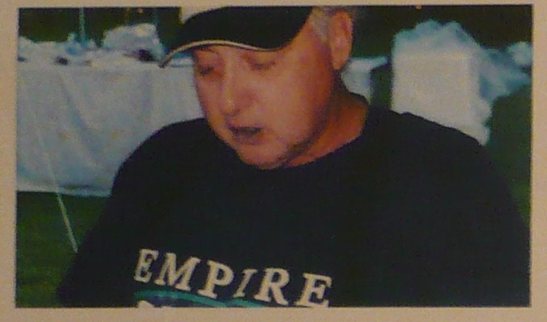
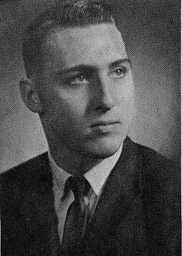
John F. Zimmerman
December 4, 1946 ~ July 27, 2007

Slide 11
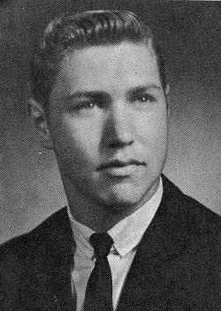
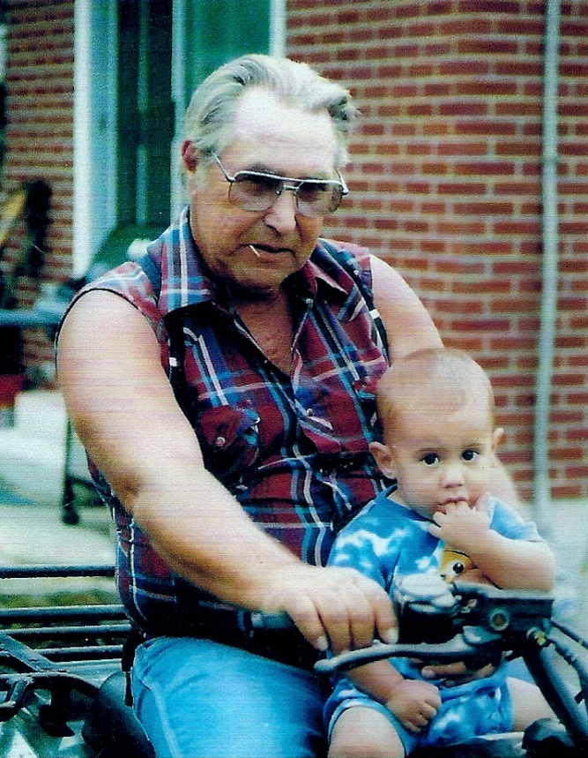
David Norman Seebold
August 23, 1948 ~ July 8, 2008

Slide 12
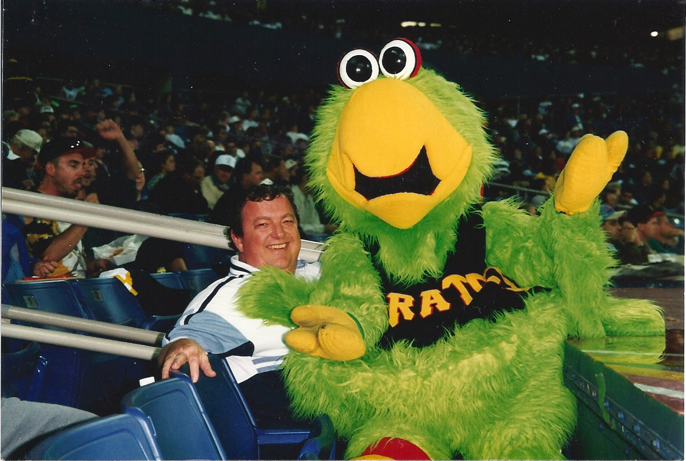
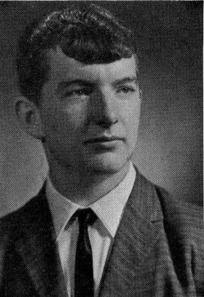
Terry William Shively
December 6, 1948 ~ November 14, 2008

Slide 13
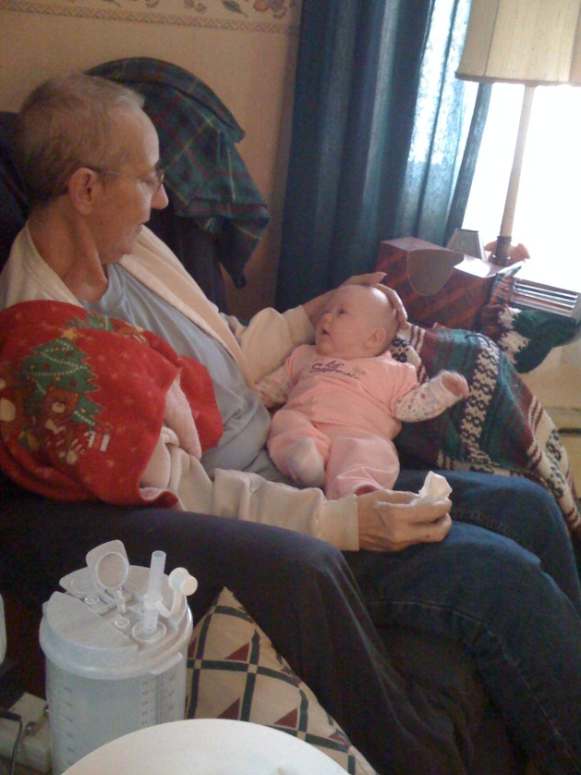
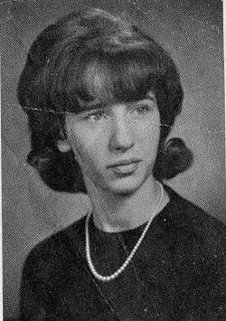
Barbara Jean (Morrison) Dietrich
October 2, 1948 ~ June 6, 2009

Slide 14
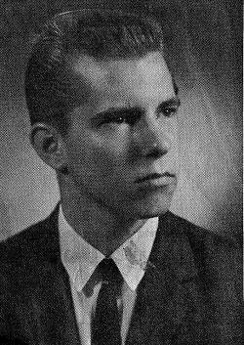
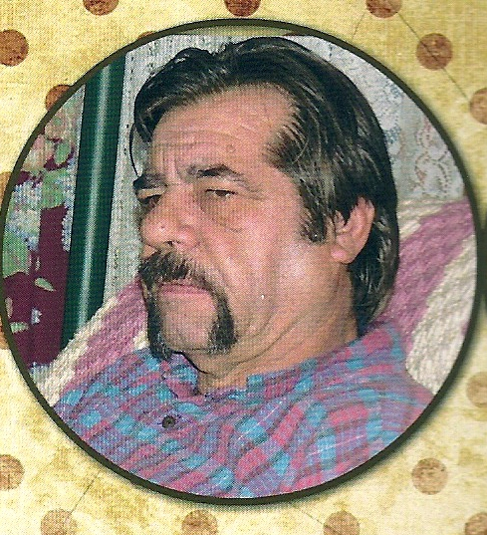
Chester Ray Koonsman
November 29, 1947 ~ February 12, 2010

Slide 15
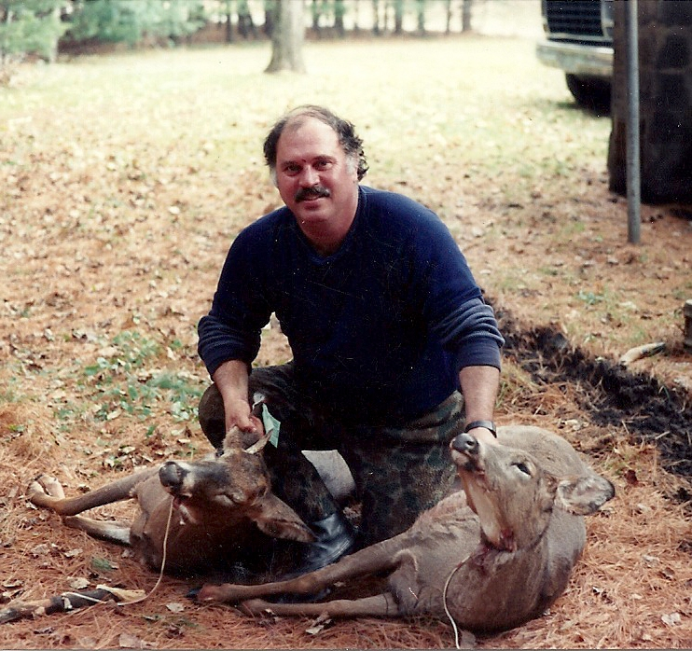
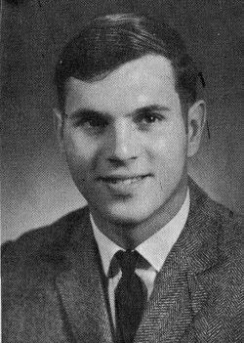
Robert M. Ely
November 5, 1947 ~ July 8, 2011

Slide 16
YOU ARE MISSED
BY YOUR CLASSMATES

